Slide 1
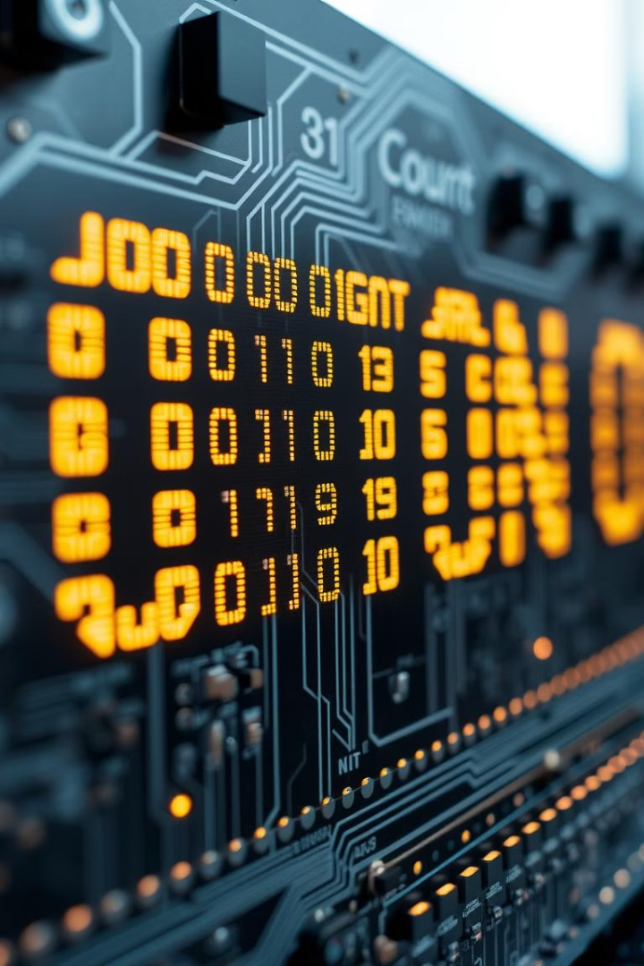
Binary Adder Project
This project implements a binary adder using Python. It simulates the 8085 microprocessor architecture. The goal is to understand digital arithmetic and microprocessor programming.
SARANSH SINGH
RA2212703010013
SRM Institute of Science and Technology

Slide 2
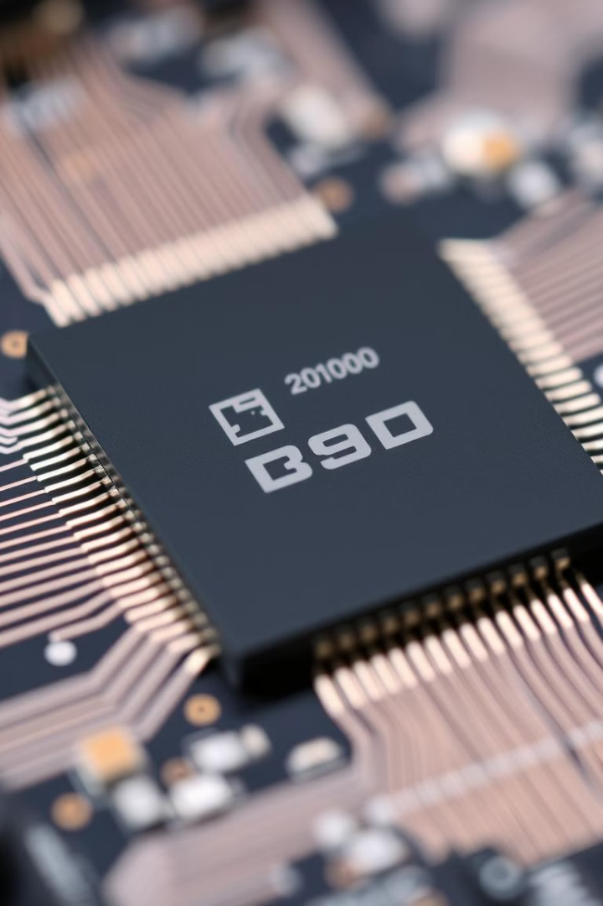
Project Objective
1
Binary Adder
2
8085 Simulation
Implement the Binary Adder algorithm in Python.
Simulate the 8085 microprocessor architecture.
3
Digital Arithmetic
Understand fundamental principles of digital arithmetic.

Slide 3

Abstract
8085 Microprocessor
Binary Addition
Visual Representation
Simulate the 8085 microprocessor in Python.
Perform binary addition using appropriate instructions.
Show the microprocessor's internal states during execution.

Slide 4
Introduction to Binary Addition
Fundamental Operation
8085 Microprocessor
Python Simulation
Binary addition is essential in digital electronics.
Offers a platform for implementing binary addition.
Python simulates the 8085 microprocessor's behavior.

Slide 5
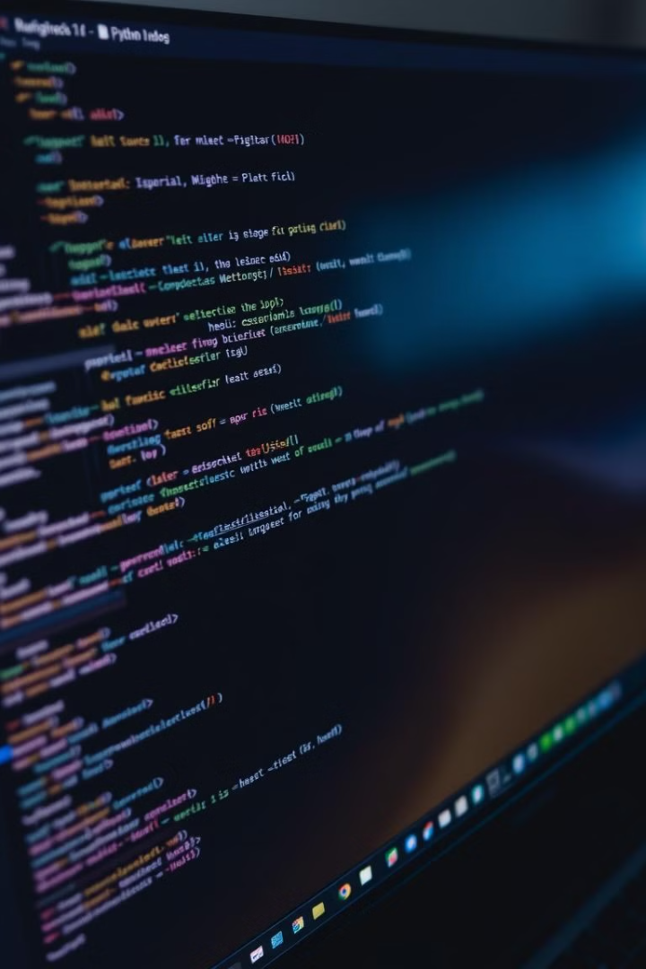



Software Requirements
Python Interpreter
Code Editor
Operating System
For writing and editing the Python code.
Required for implementing the simulation.
Compatible with common operating systems.

Slide 6
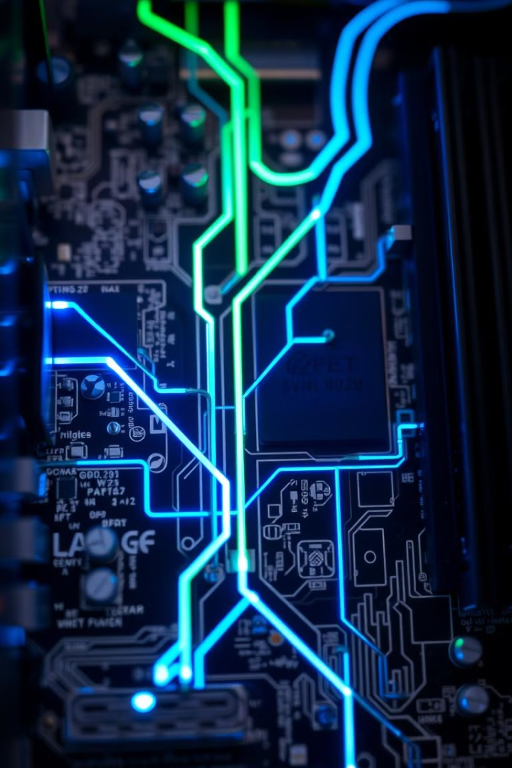



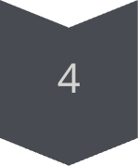
Working Principle
Initialization
Create virtual registers and load binary numbers.
Binary Addition
Simulate ALU operation for each bit position.
Update Flags
Simulate flag updates based on the result.
Result
Store the result in designated virtual registers.

Slide 7

Conclusion
1
Digital Arithmetic
Demonstrates principles of digital arithmetic.
2
Binary Number System
Explores the binary number system and bitwise operations.
3
Python Versatility
Showcases Python's ability to handle binary operations.

Slide 8
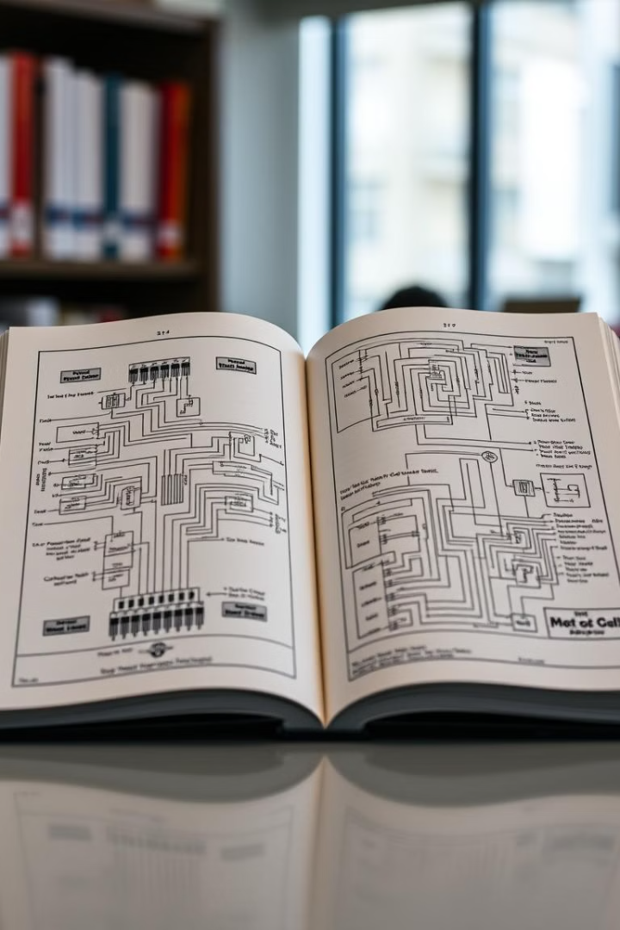
References
Javatpoint
Studocu
Detailed explanation of binary adders.
Practical implementation of adders using logic gates.
The Developer Blog
Interconnections of full-adder circuits.

